Slide 1

Traffic Analysis and Severity Prediction
Thinkful Final Capstone
Genesis Taylor

Slide 2
Background
The UK government collects and publishes (usually on an annual basis) detailed information about traffic accidents across the country. This information includes, but is not limited to, geographical locations, weather conditions, type of vehicles, number of casualties and vehicle maneuvers, making this a very interesting and comprehensive dataset for analysis and research.
The data for this project is available on Kaggle as UK Road Safety: Traffic Accidents and Vehicles

Slide 3
Importance of Analyzing Traffic Accidents
Accurately analyzing accidents can help governments to better the safety of their roads and highways.
Identifying high areas of accidents and high areas of accident severity can highlight areas of concern.
It can also be beneficial to insurance companies looking to changer their rates in different areas.

Slide 4
Agenda
The goal of this project is to investigate and determine what causes accidents and what attributes to their level of severity.
Through visualizations and machine learning algorithms, areas of concern will be highlighted, and the seriousness of accidents will be predicted as accurately as possible.

Slide 5
Data Introduction Details
The data for this project is obtained from a user on Kaggle and was composed from information on the United Kingdom’s Government Open Data website.
It consists of two different datasets that contain information from 2005-2017 that were combined on a common field (accident_index).
Vehicle_Information.csv: A file containing information about the vehicles, point of impact, maneuvers made, driver information, etc.
Accident_Information.csv: A file containing details about the accident that include location, junction details, date and time, accident severity, etc.

Slide 6
Research Questions
What are the limitations of the current data?
What things would help this research to be more accurate?
Can we forecast the number of accidents in upcoming years based on the information available?
Who does this project benefit?
Can we create a machine learning algorithm that correctly predicts the severity of accidents?
When do/did the most accidents happen?
How do the available factors contribute to accident seriousness?

Slide 7
Who does this project benefit?
Government Departments of Transportation
Create safer highways
Prevent fatalities
Reduce severity
Educate the public

Slide 8
When do/did the most accidents happen?
The following charts display the number of accidents by year, month, season and day of the week.
The trends for each time period are displayed for analysis and reviews.

Slide 9
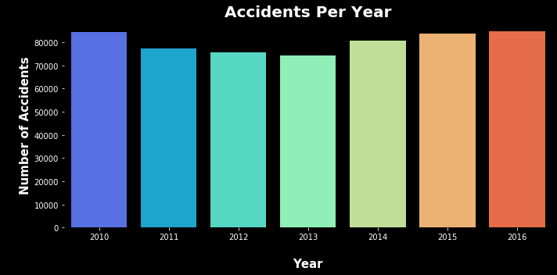
Accidents per Year
According to the graph above, from 2010 to 2013, there was a decrease in the number of accidents, however over the past few years there has been an increase in accidents, with 2016 being close to the 2010 numbers.

Slide 10
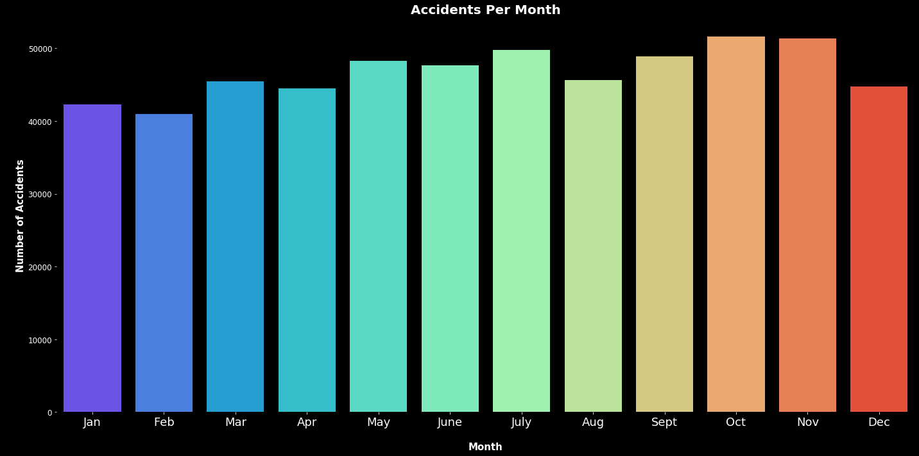
Accidents per Month
According to the graph above, the majority of accidents happen between May and July and September and November.

Slide 11
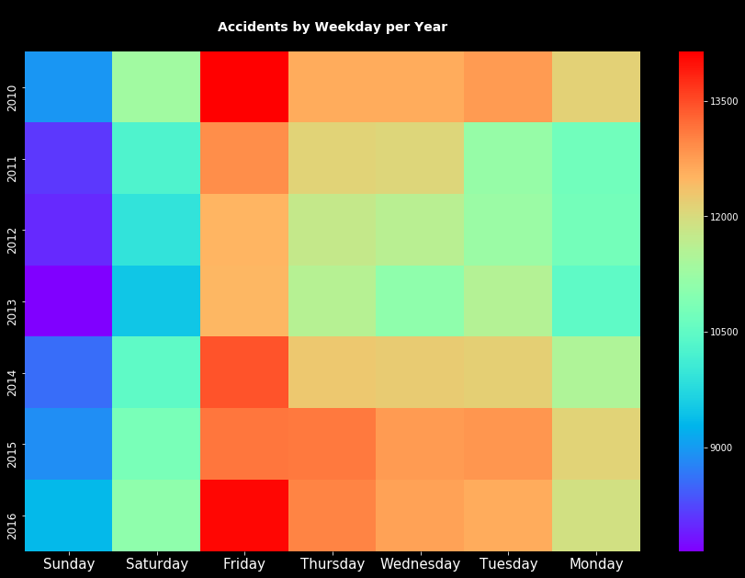
Accidents Per Weekday Per Year
Fridays are the day of the week where the most accidents occur in each year. More information can help to explain this occurrence better.

Slide 12
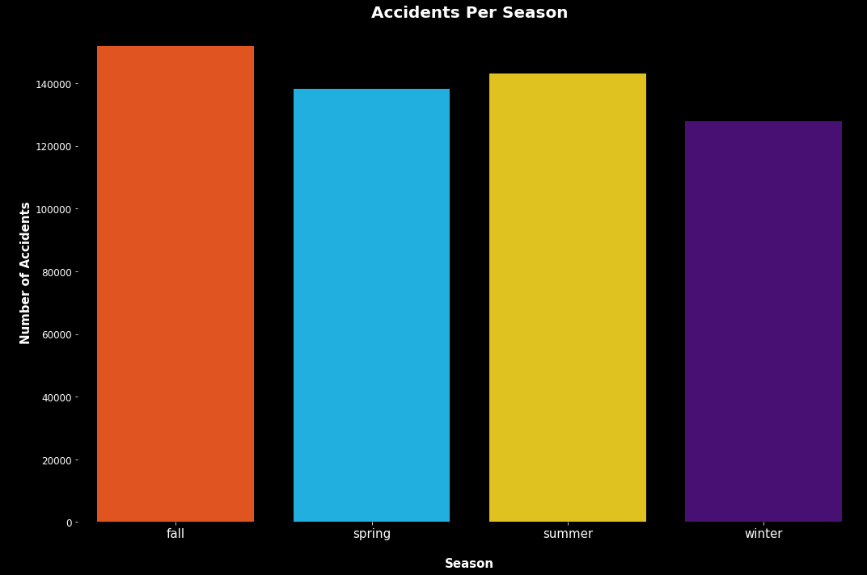
Accidents Per Season
Summer and Fall have the highest number of accidents. These match with the accidents per month and are something for governments to look at closer and compare to whatever events are in the area.

Slide 13
How do the available factors contribute to accident seriousness?
did_police_officer_attend_scene_of_accident
x1st_point_of_impact
number_of_vehicles
speed_limit
urban_or_rural_area
skidding_and_overturning
vehicle_leaving_carriageway
sex_of_driver
vehicle_type
vehicle_manoeuvre
engine_capacity_cc
number_of_casualties
driver_home_area_type
age_band_of_driver
junction_control
hit_object_off_carriageway
hit_object_in_carriageway
driver_imd_decile
junction_detail
junction_location
propulsion_code
year
These features were found to have the highest relation to accident seriousness. While they may all have an impact, not every feature will be discussed in the following slides. The features discussed will be be based on the findings from their visualization.

Slide 14

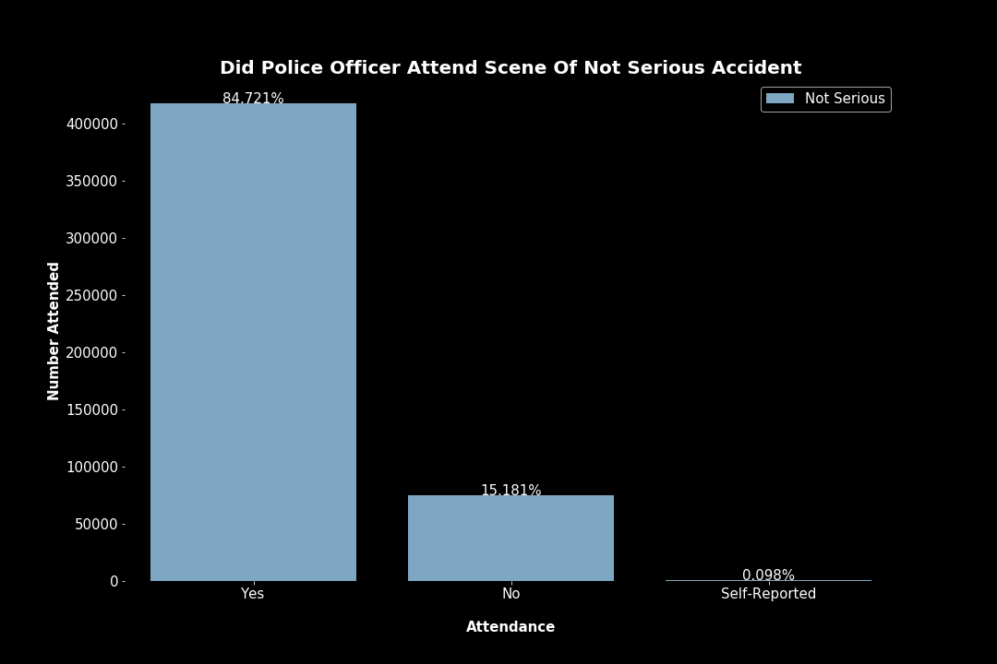
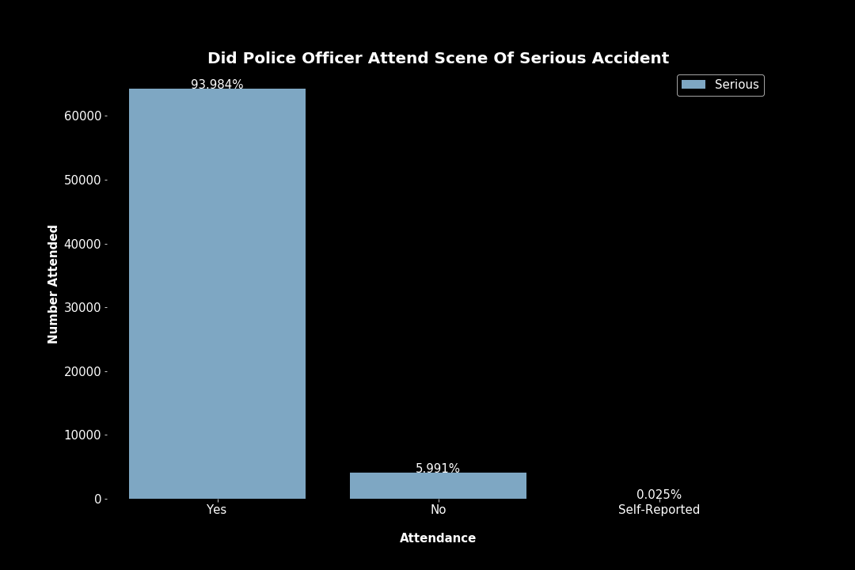
Did Police Officer Attend Scene Of Accident
Police attended most accidents but were less likely to NOT be called in serious accidents.

Slide 15
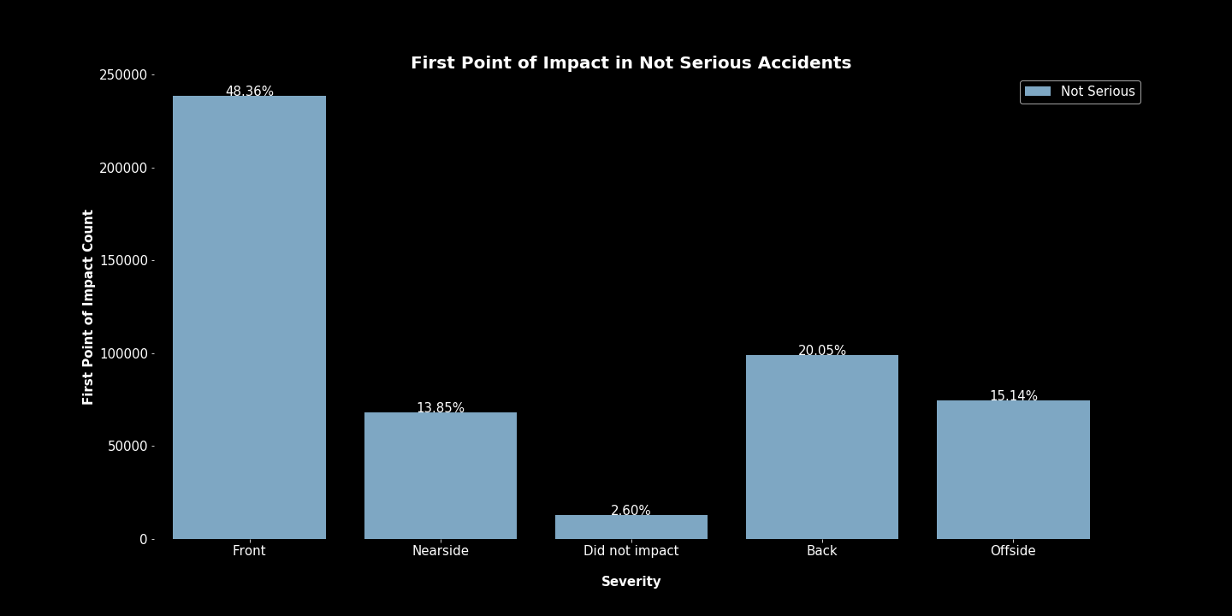
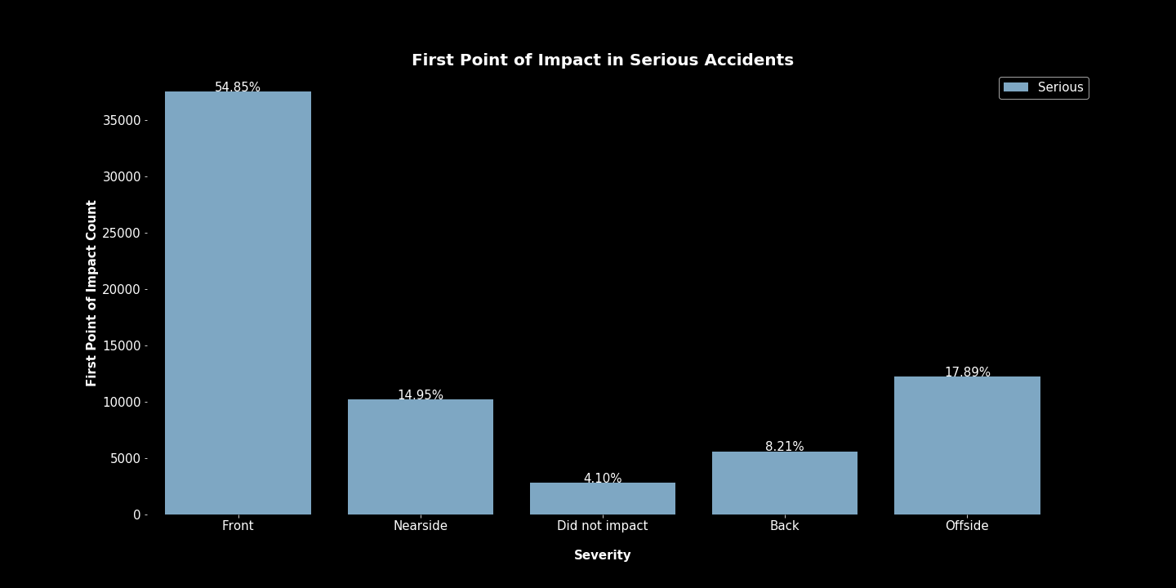
First Point of Impact
Majority of accidents were front impacted as the first point of impact. Not serious accidents had a higher percentage of Back impact accidents than serious accidents. Serious accidents had higher percentages of Offside and Nearside accidents.

Slide 16
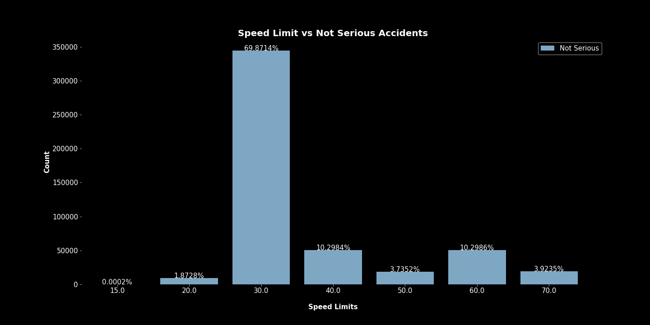
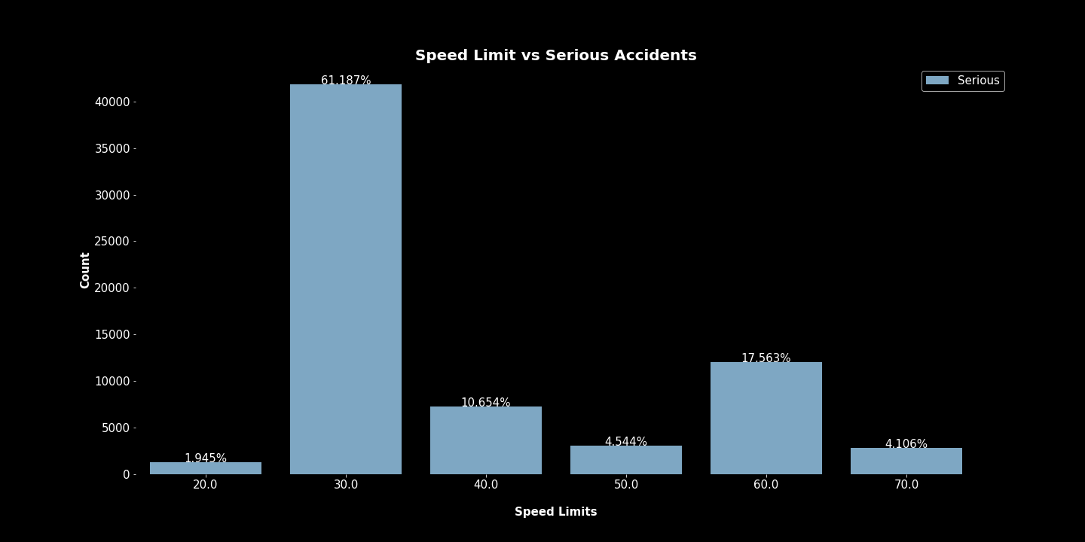
Speed Limit
Majority of accidents occurred in 30 speed limit zones. It would have been beneficial to have actual data on the speeds of the vehicles involved or at least if they were speeding.

Slide 17
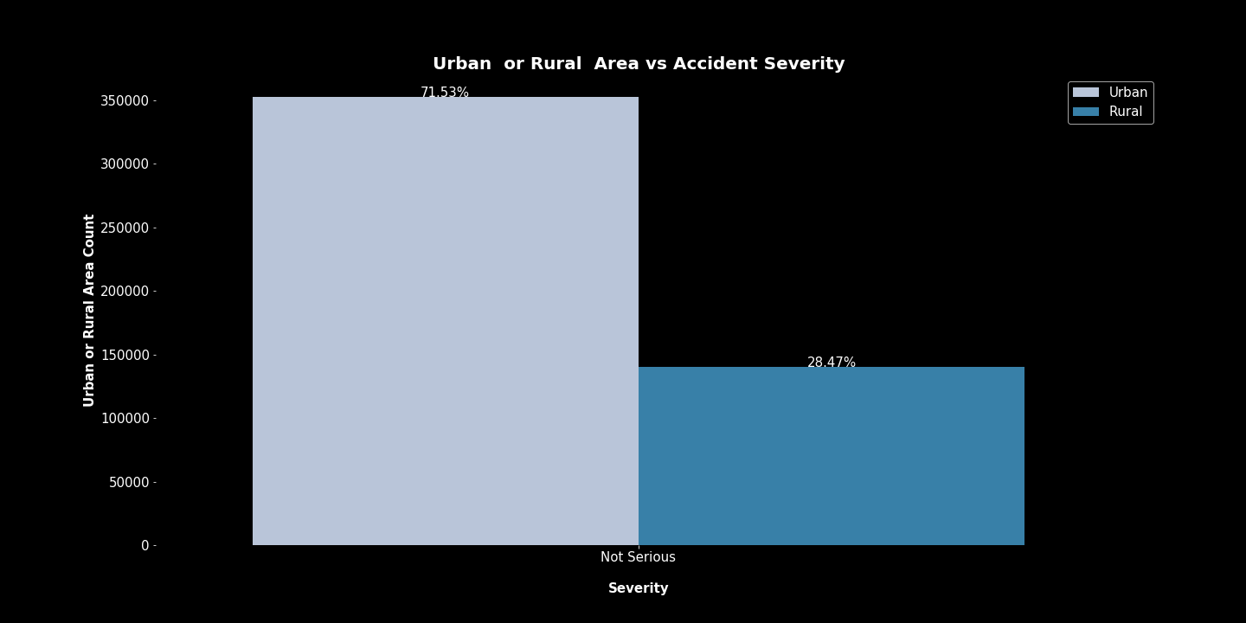
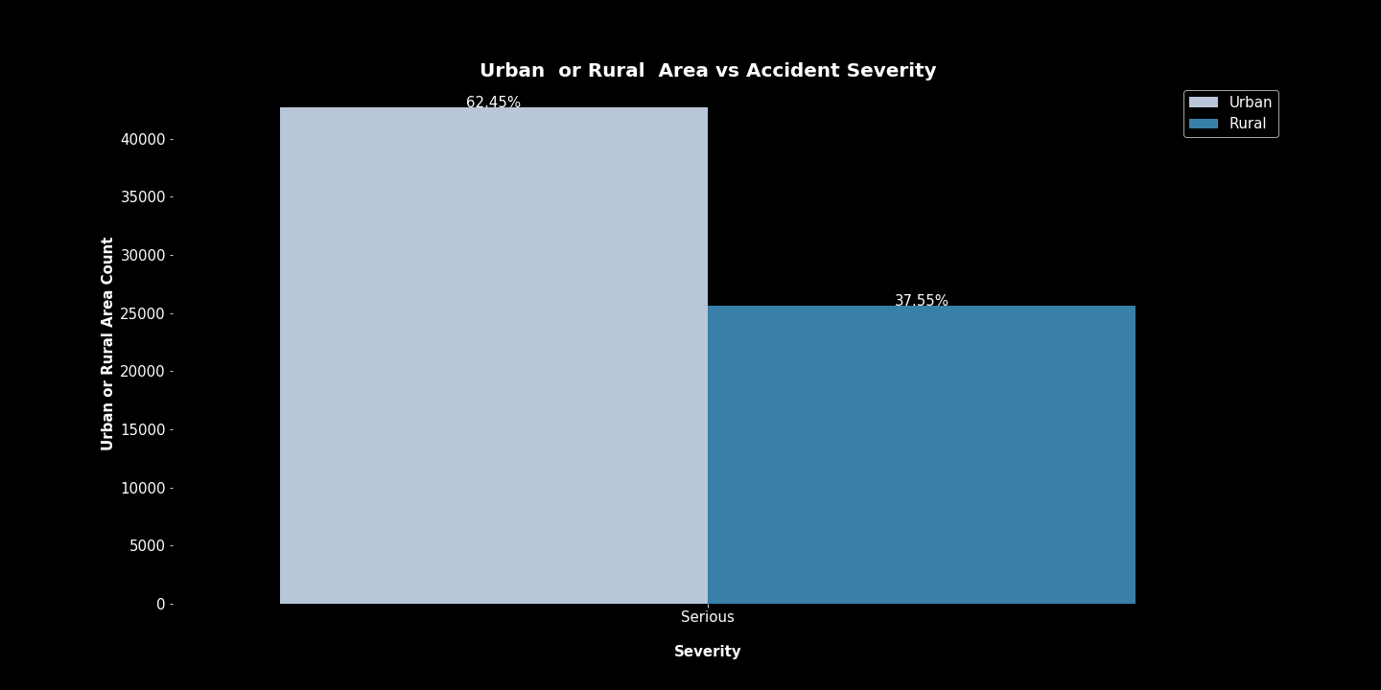
Urban or Rural Areas
Rural areas had a higher percentage of serious accidents. This may relate to hospital locations or emergency vehicle arriving to the scene of the accident, both of which are not available through this data.

Slide 18
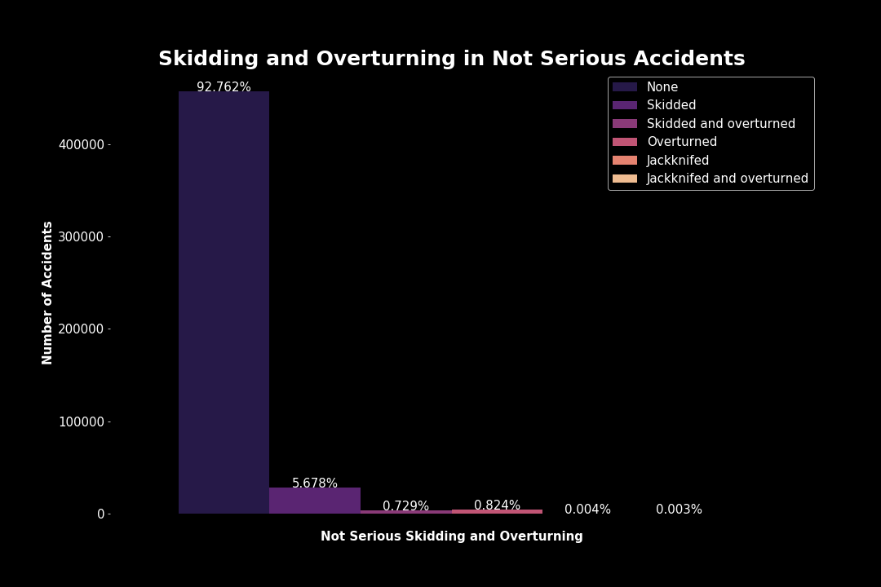
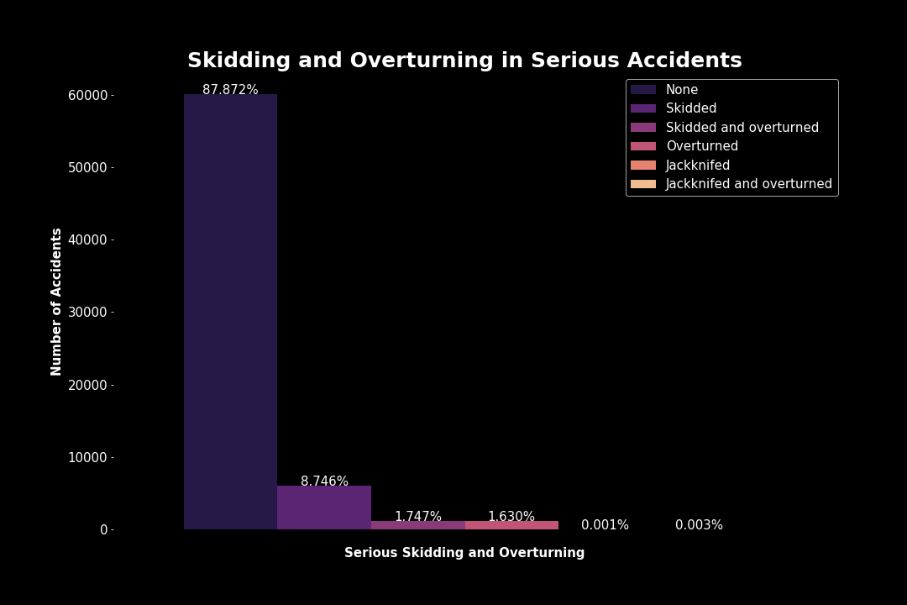
Skidding or Overturning
Higher percentages of serious accidents involved skidding, jackknifing or overturning.

Slide 19
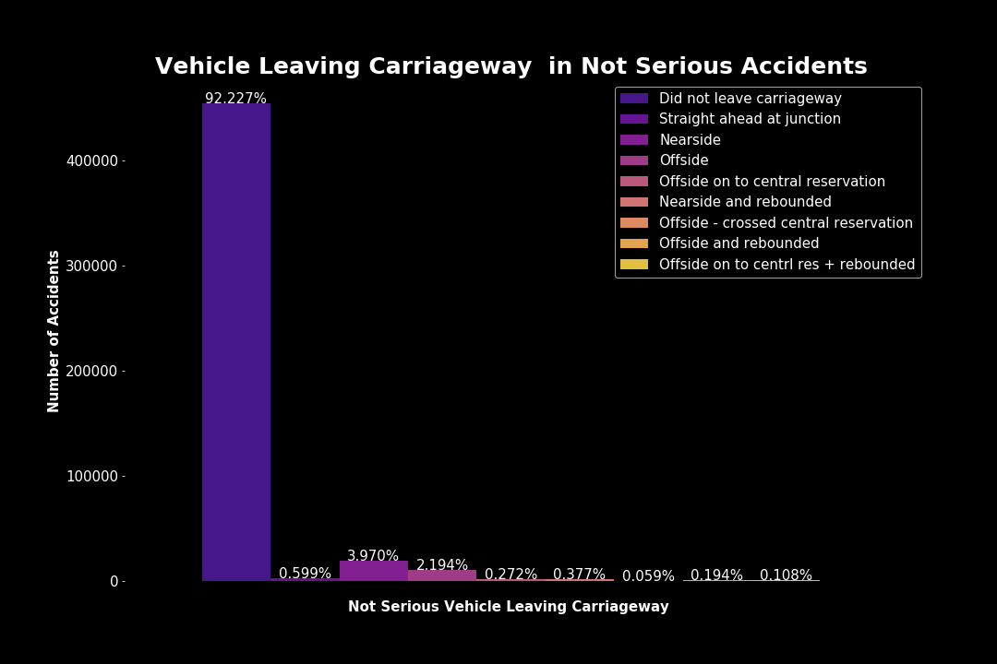
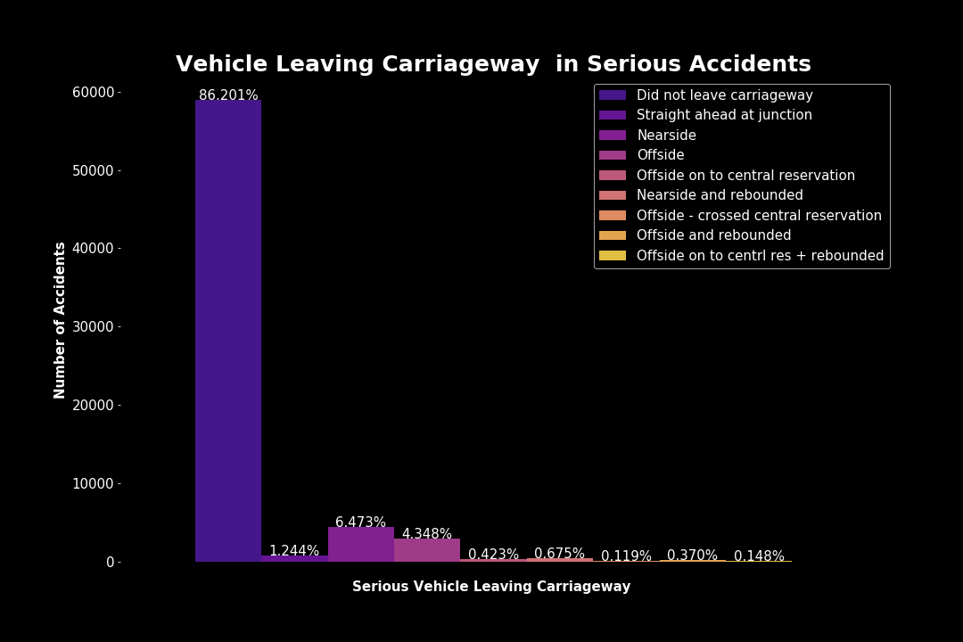
Vehicle Leaving Carriageway
Most vehicles did not leave the carriageway in either type of accident, however serious accidents had higher percentages of those that did leave the carriageway.

Slide 20
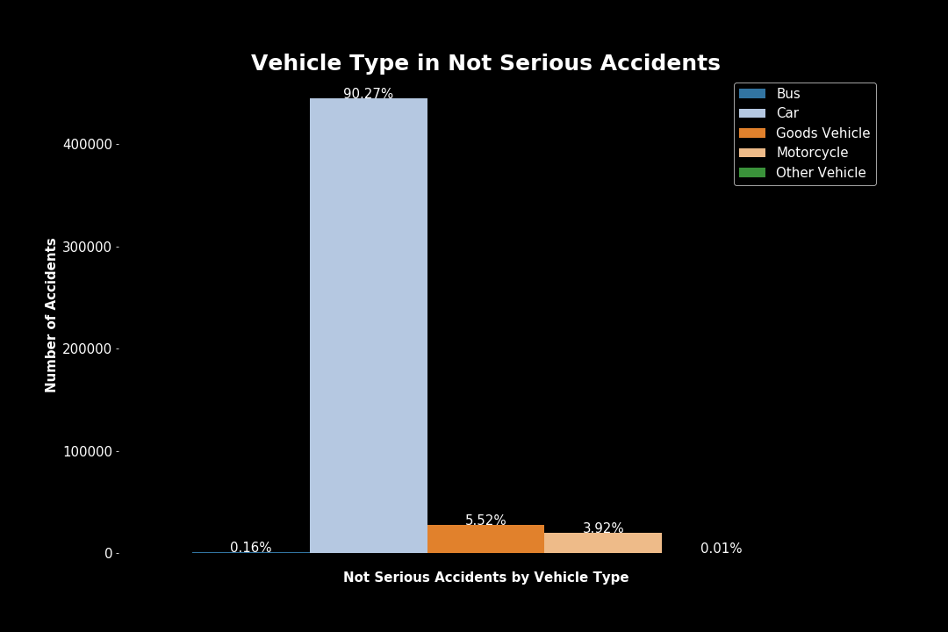
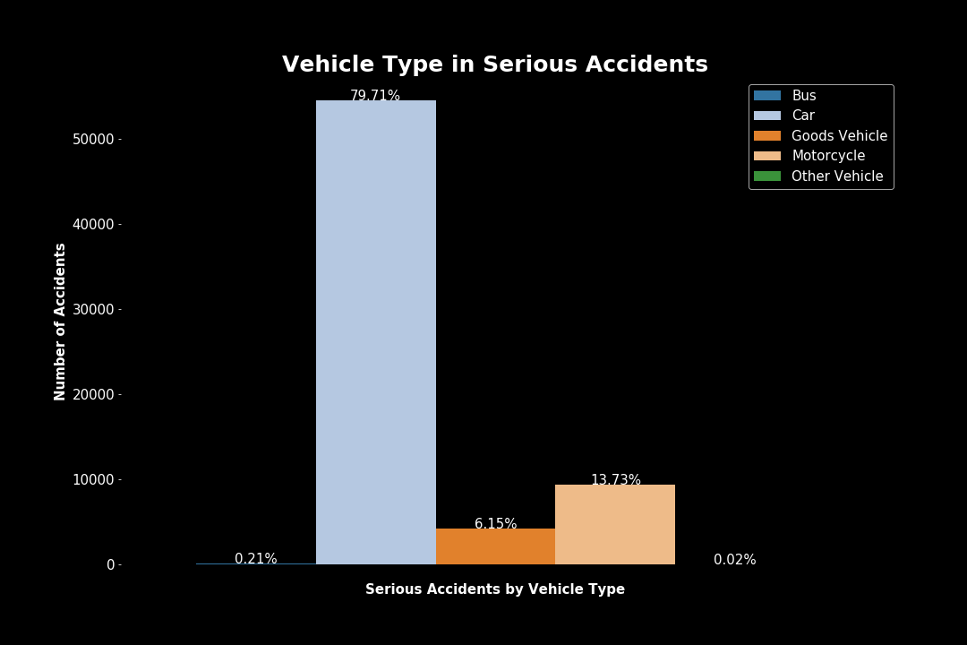
Vehicle Type
Motorcycles were involved in a significantly higher percentage of serious accidents than not serious accidents.

Slide 21
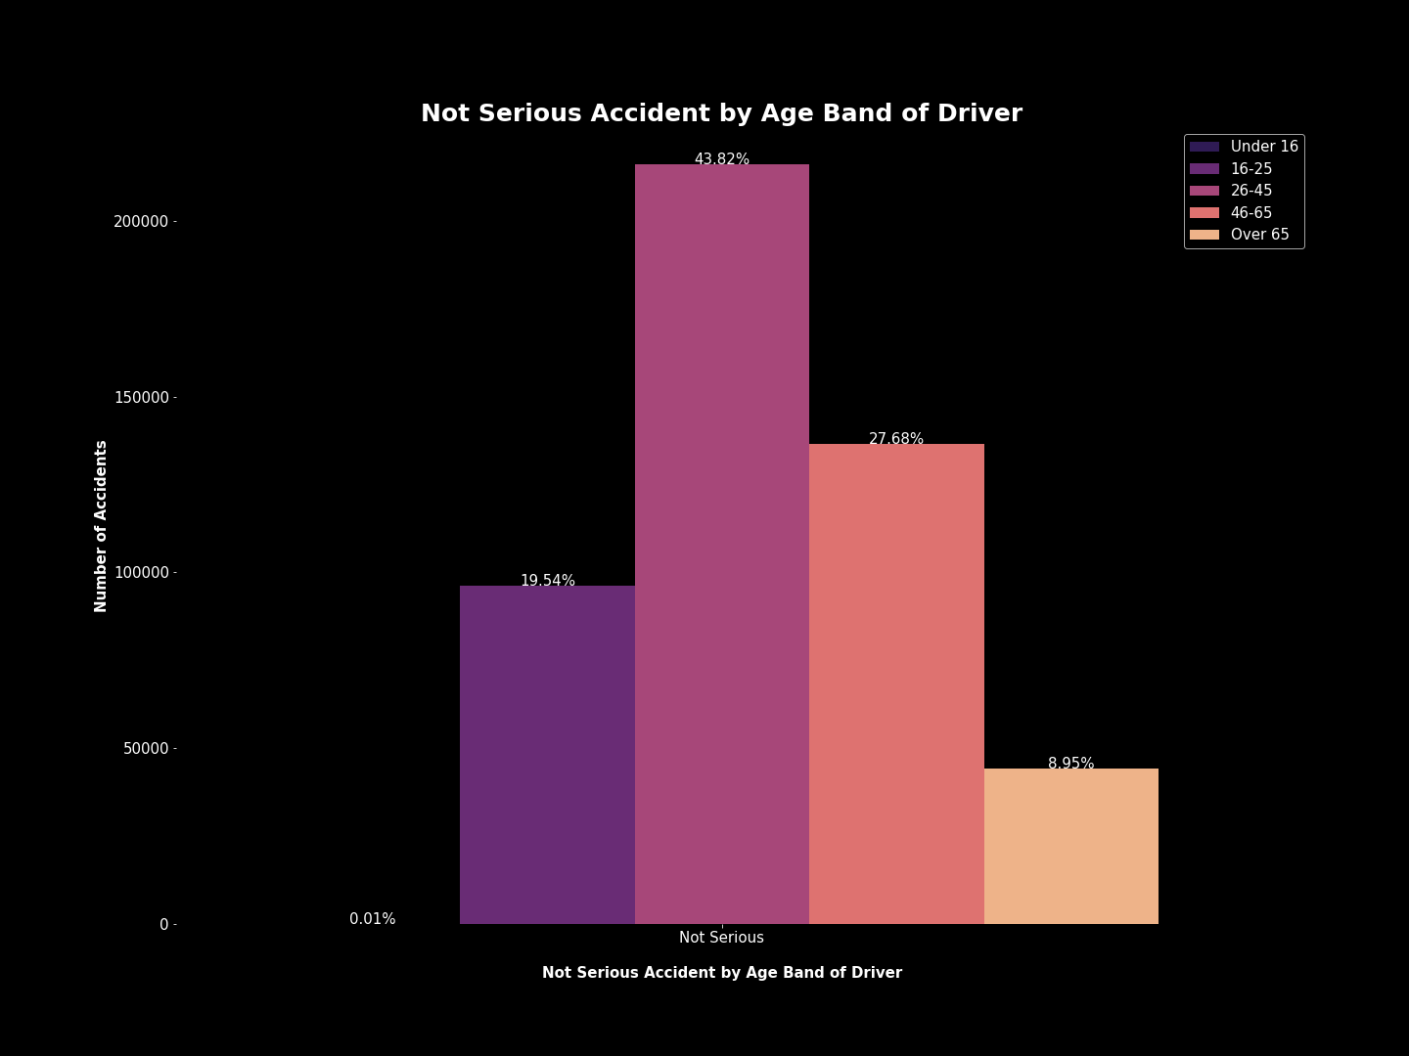
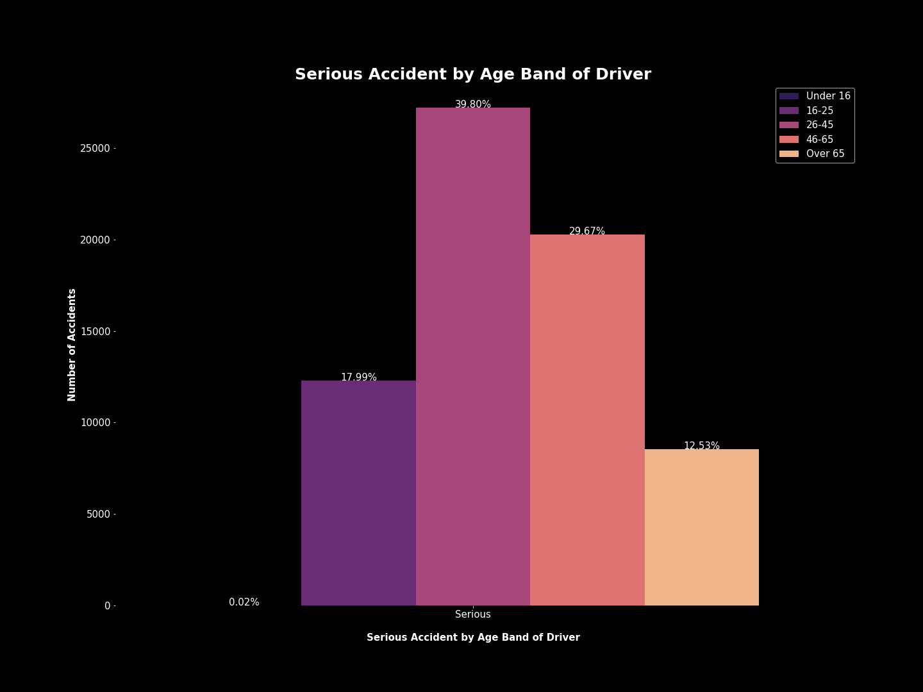
Age Band of Driver
The age groups over the age of 25 had a higher percentage of serious accidents than not serious.

Slide 22
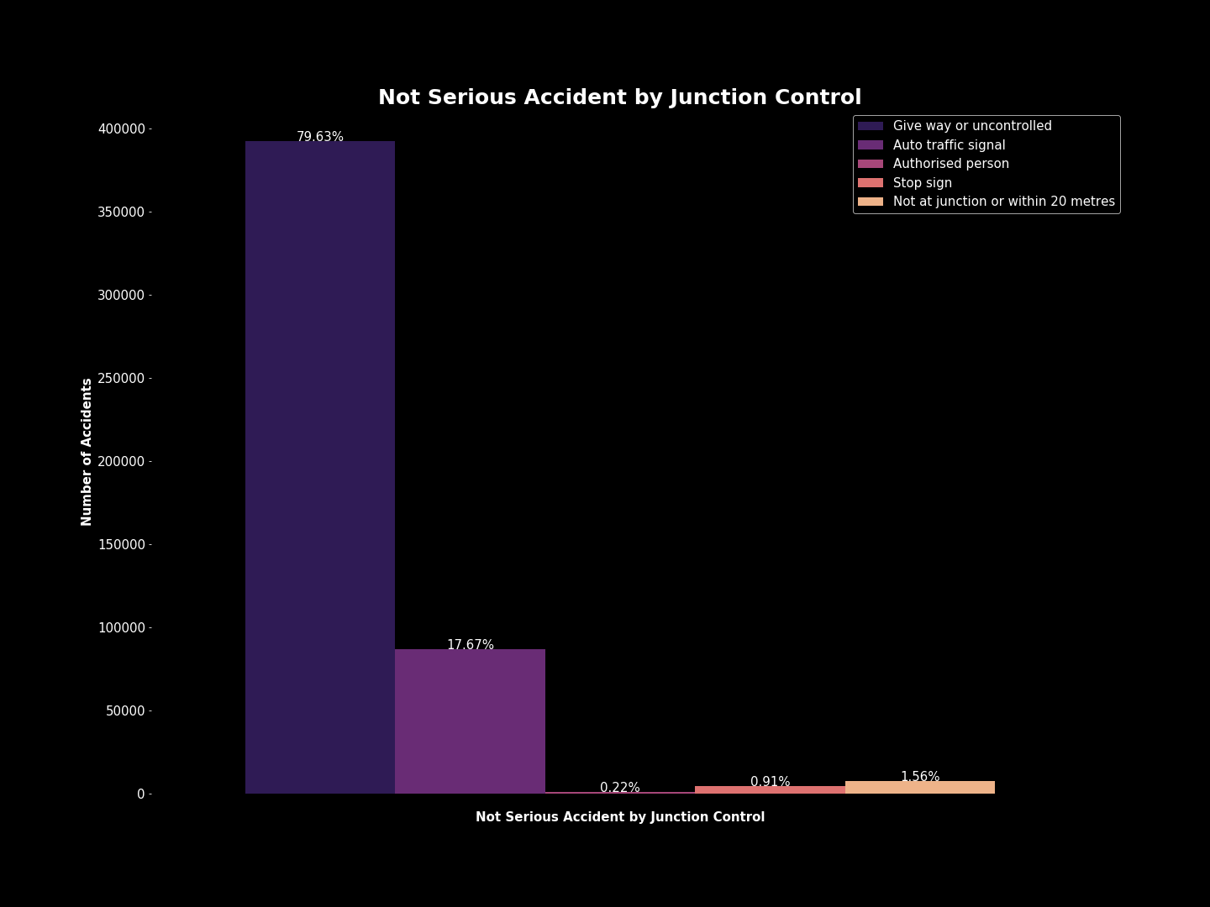
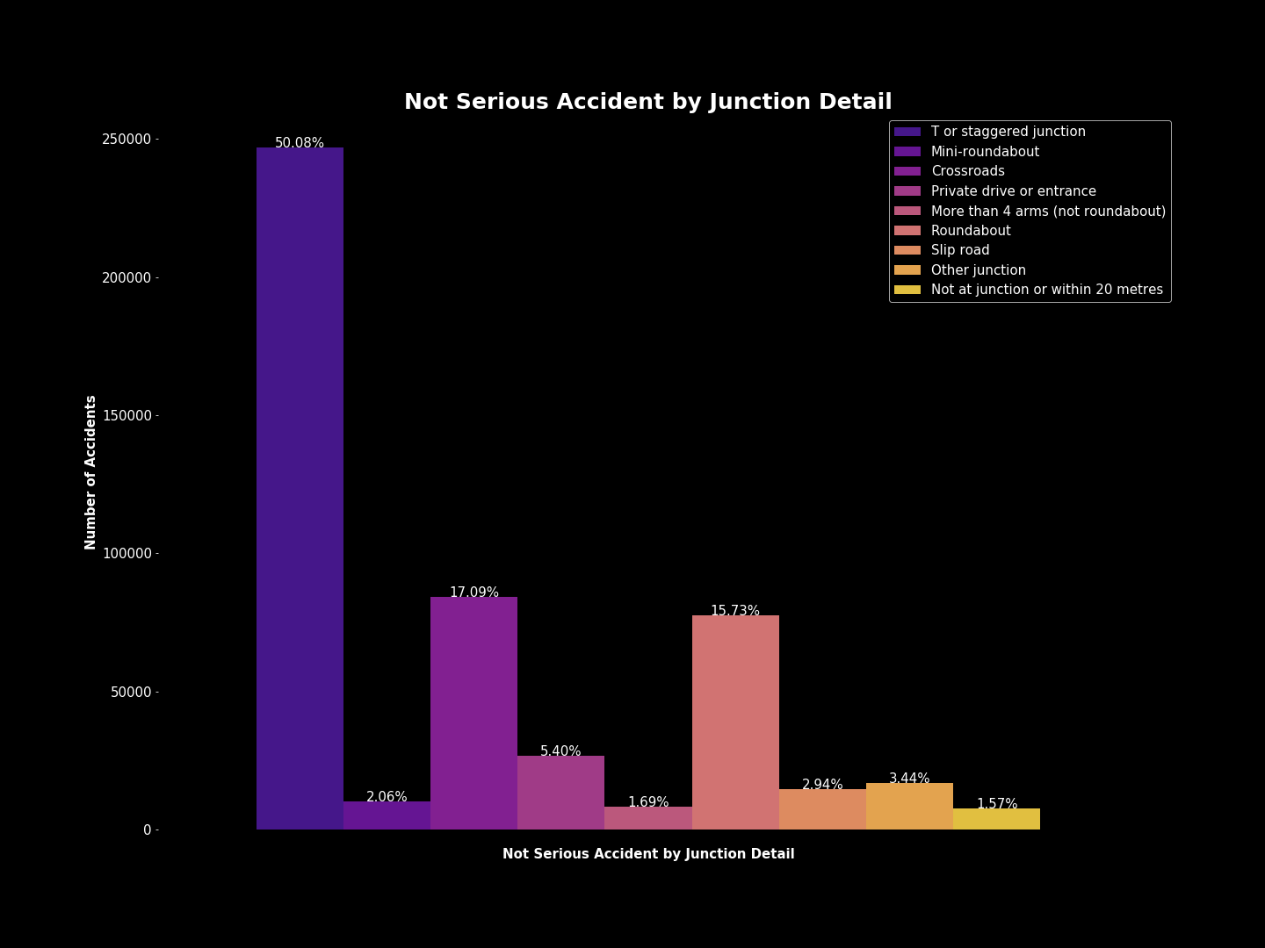
Junction Control
Most areas with accidents were uncontrolled.

Slide 23
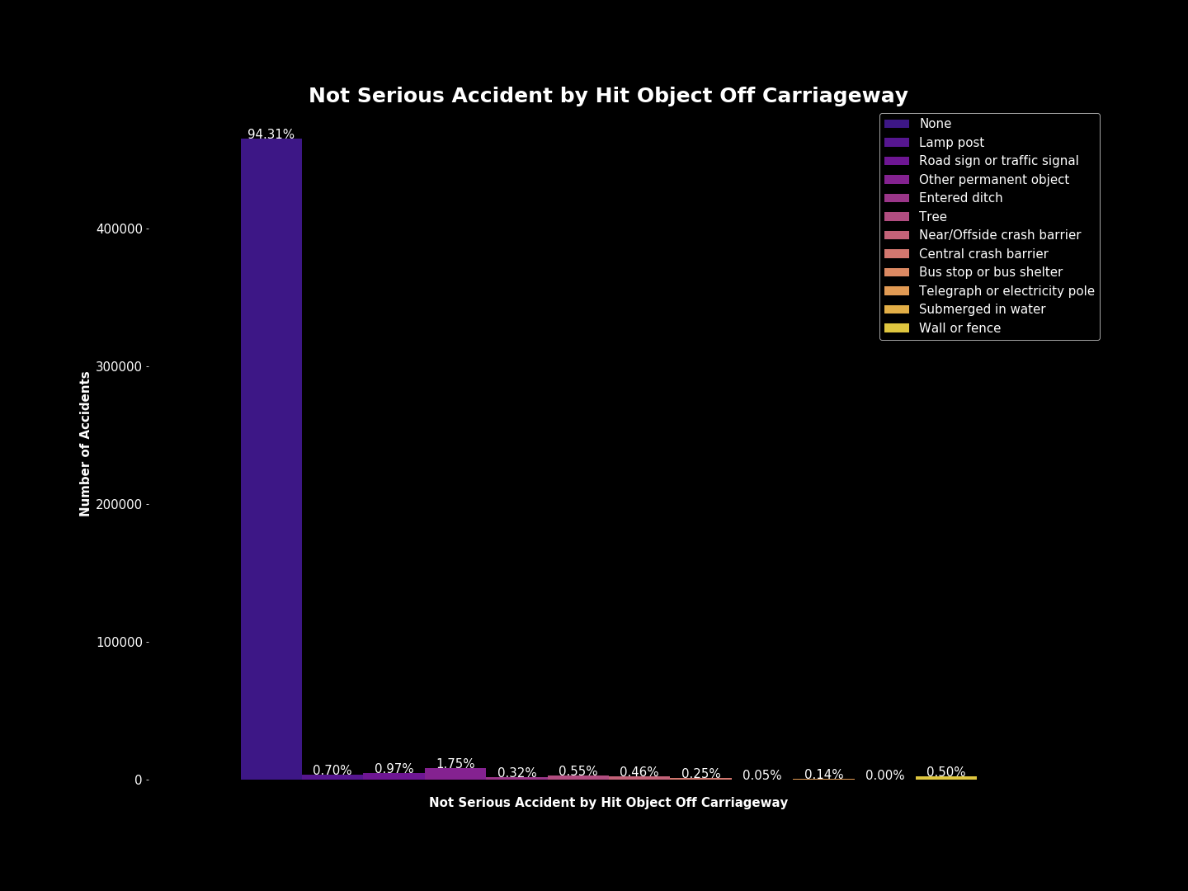
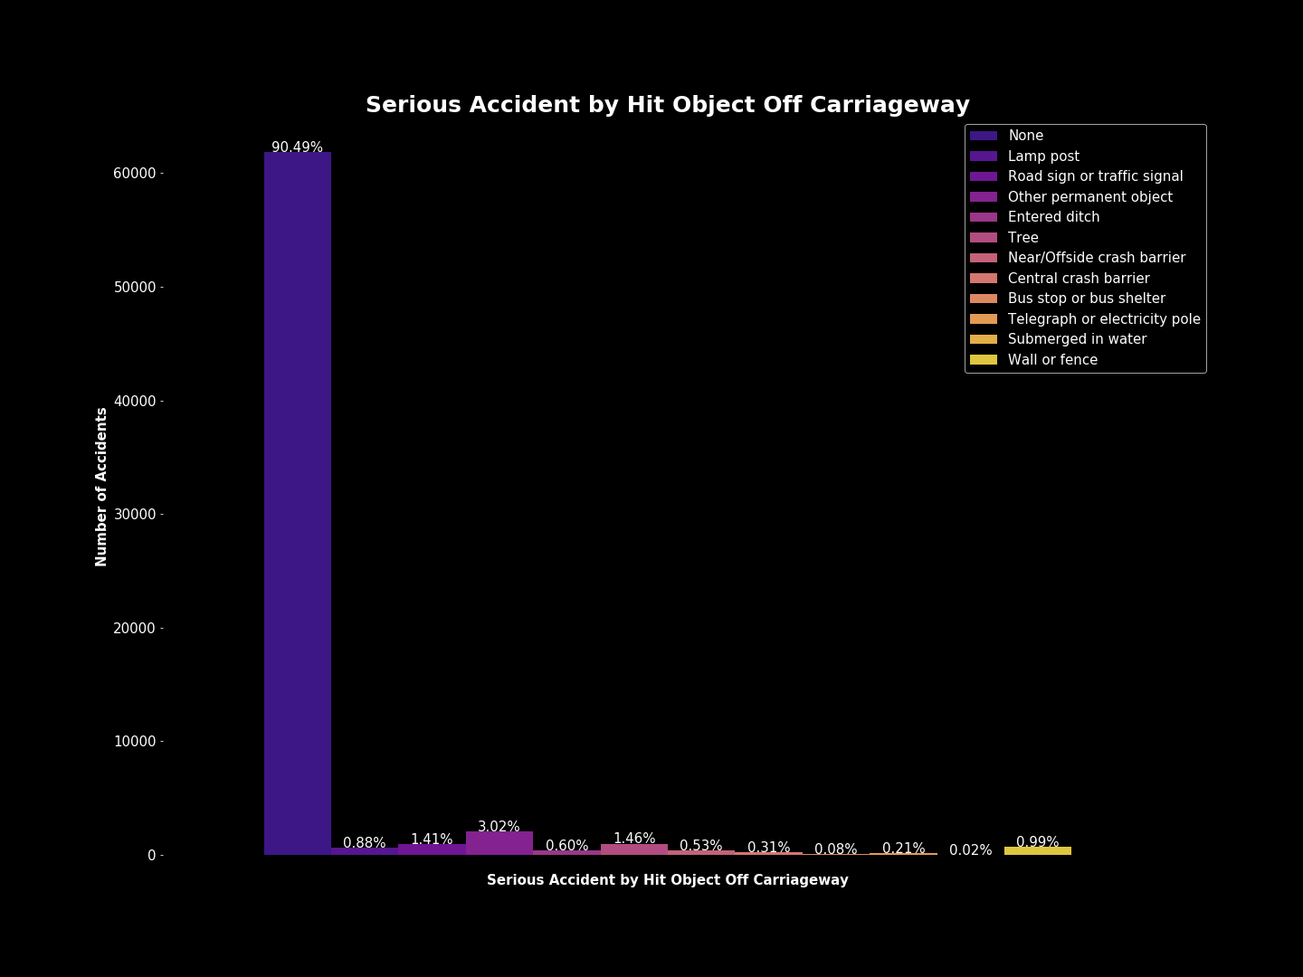
Hit Object Off Carriageway
Most accidents did not involve objects being hit off the carriageway, however serious accidents had higher percentages of accidents that did involve hitting an object off the carriageway.

Slide 24
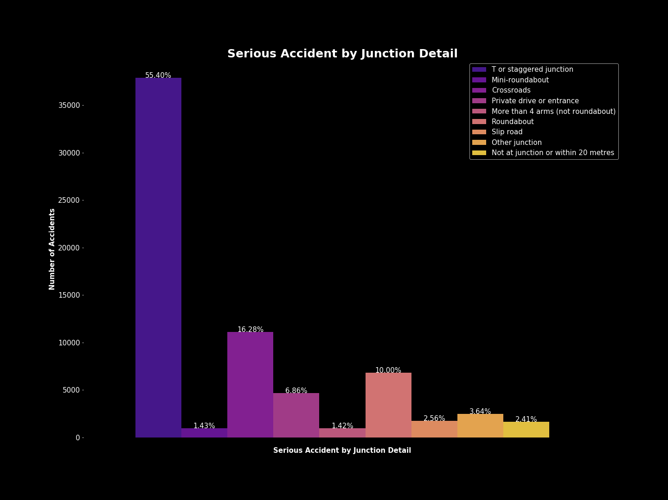
Junction Detail
T or staggered junctions were where most of the accidents occurred.

Slide 25
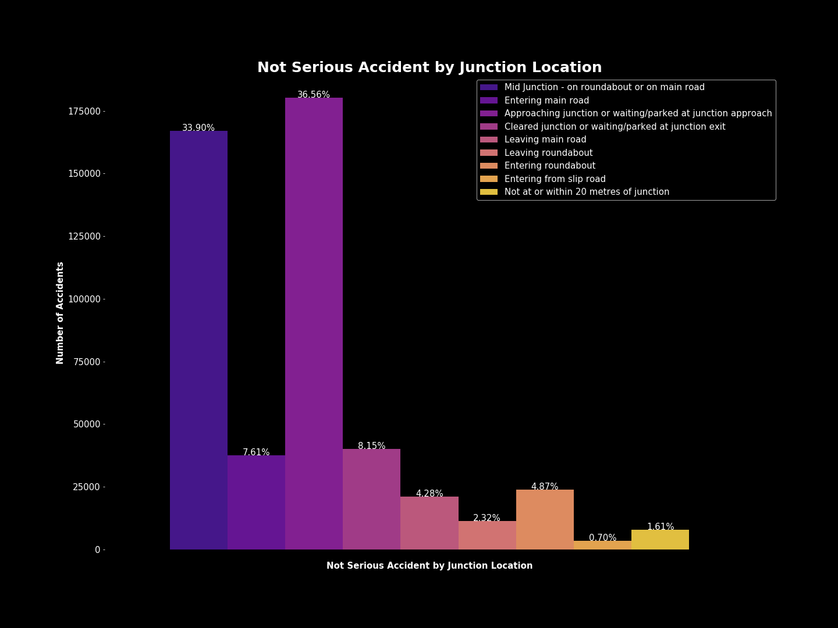
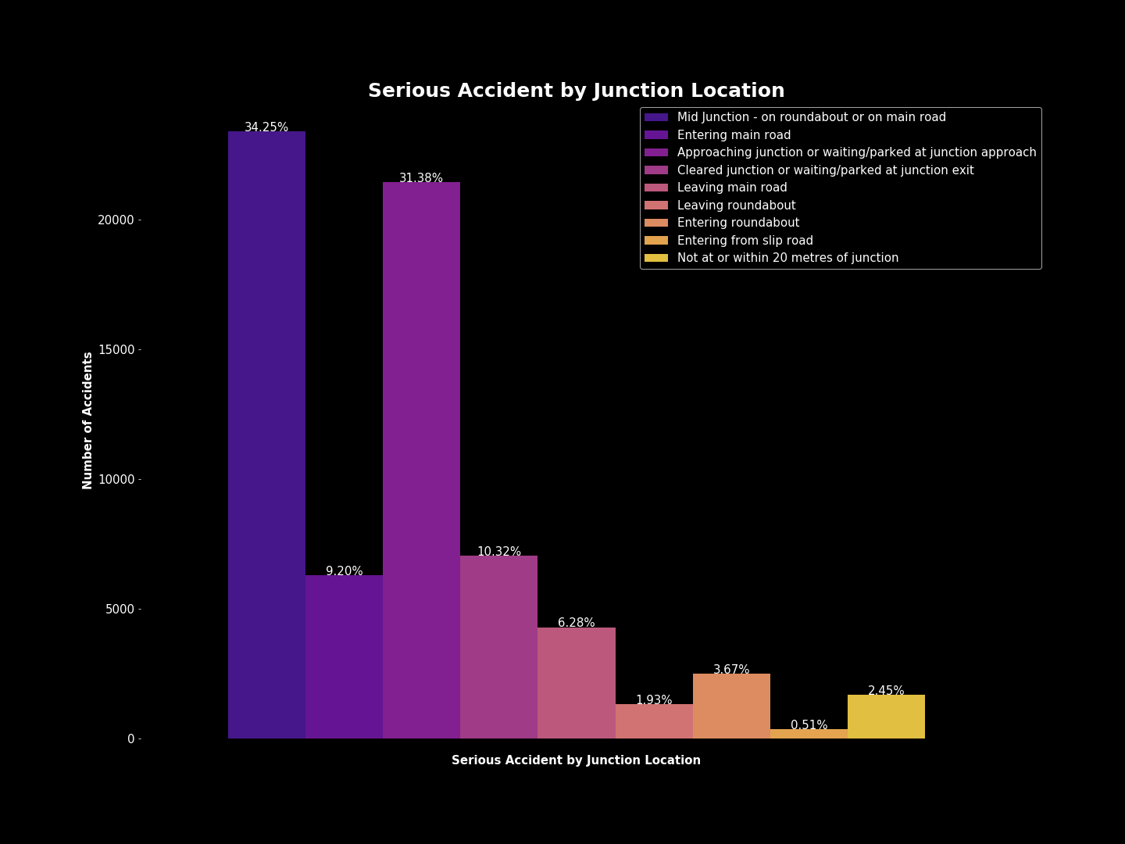
Junction Location
Most accidents seem to have occurred in the “Mid Junction - on roundabout or on main road” or situations where the driver was “approaching the junction or waiting/parked at junction approach”.

Slide 26
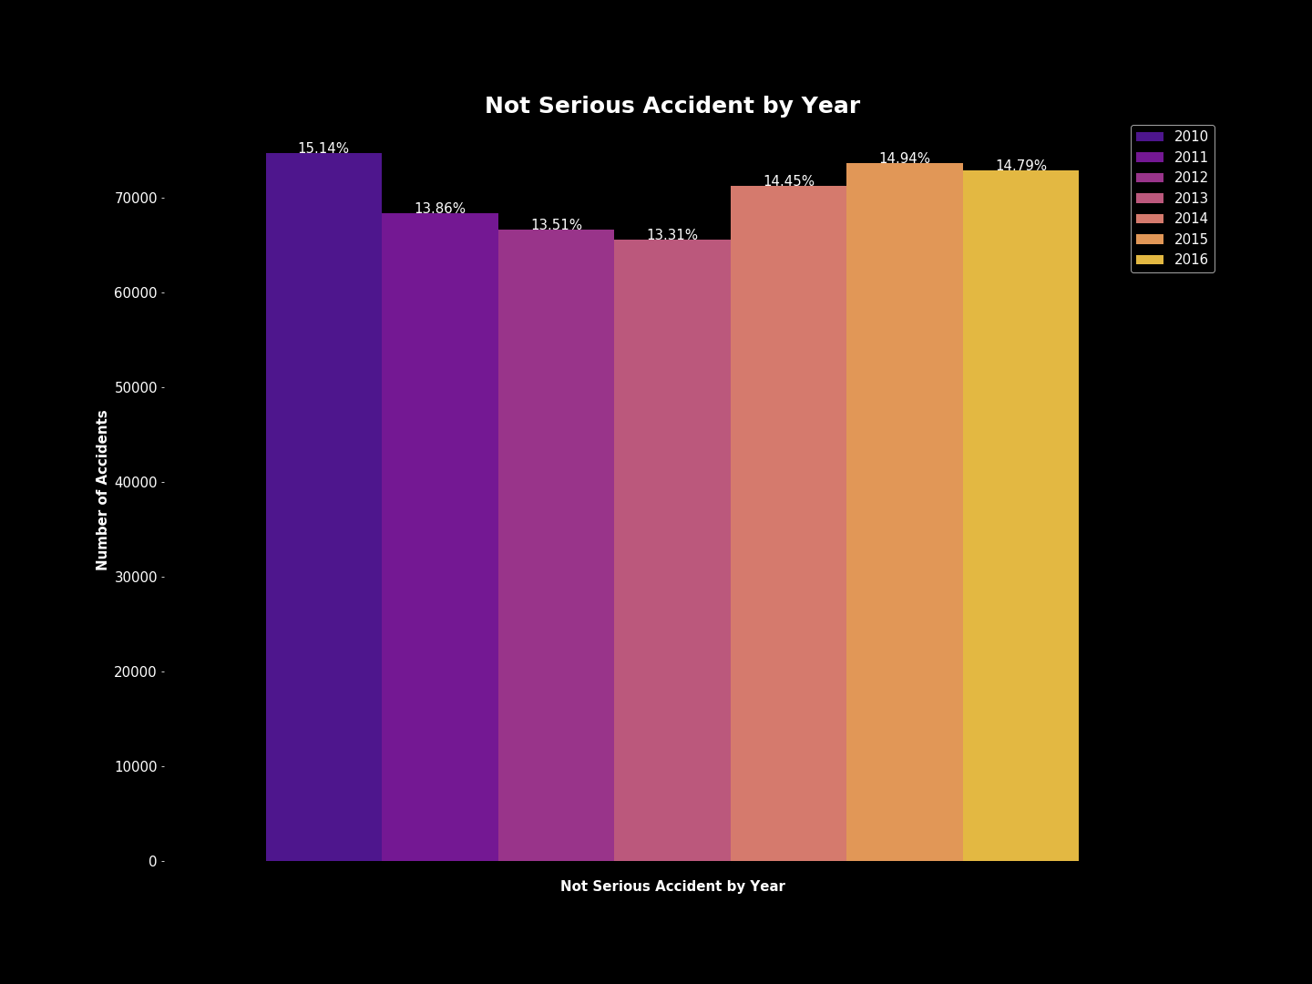
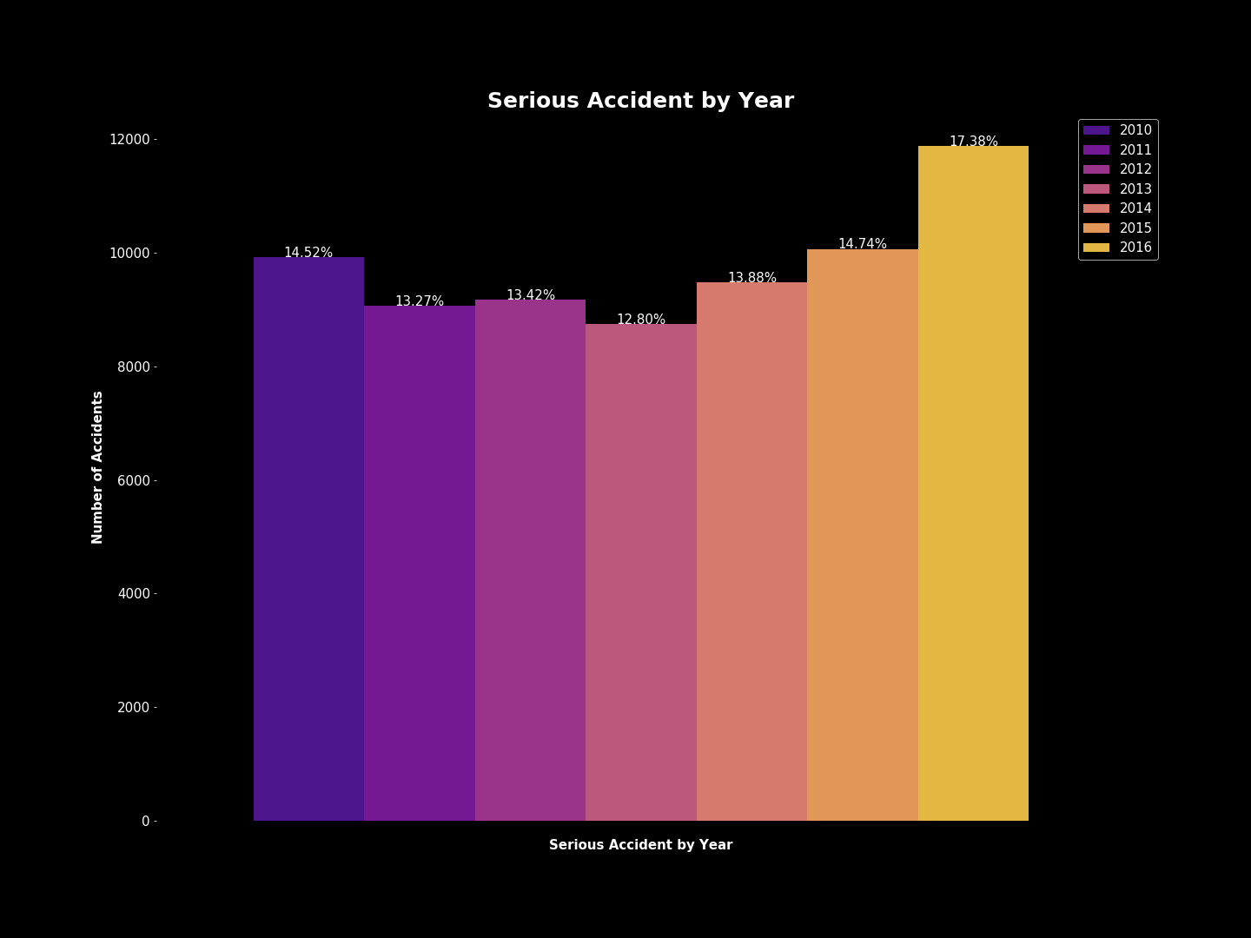
Year
There has been a spike in percentage of serious accidents over the years. However, the percentage of not serious accidents has remained somewhat consistent.

Slide 27
Other Visualizations
Junction Control by Junction Detail
Junction Control by Junction Location
First point of Impact by Junction Detail
First point of Impact by Junction Location
Junction Control and First Point of Impact
Due to the previous visualization a comparison of certain variables was desired to see more correlations. The comparisons listed above will be displayed in the slides to follow.

Slide 28
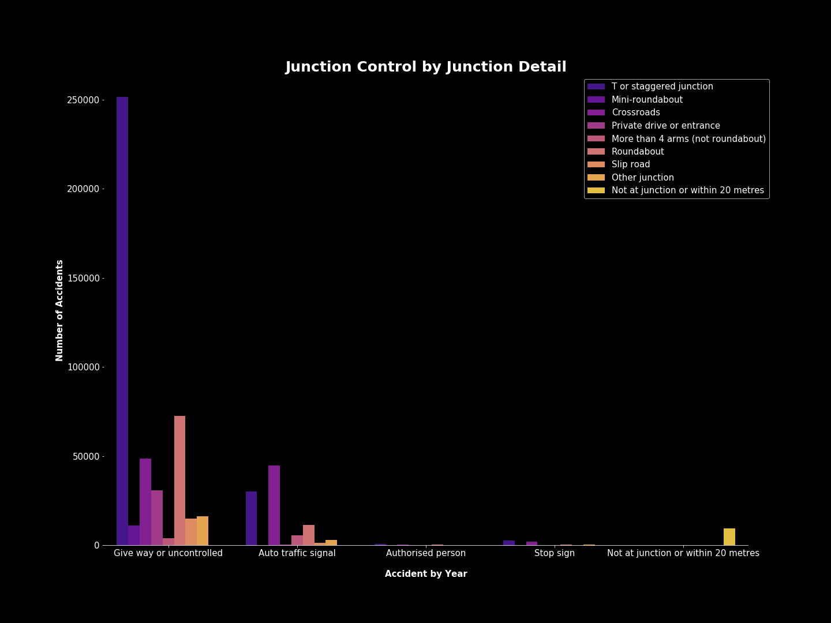

Slide 29
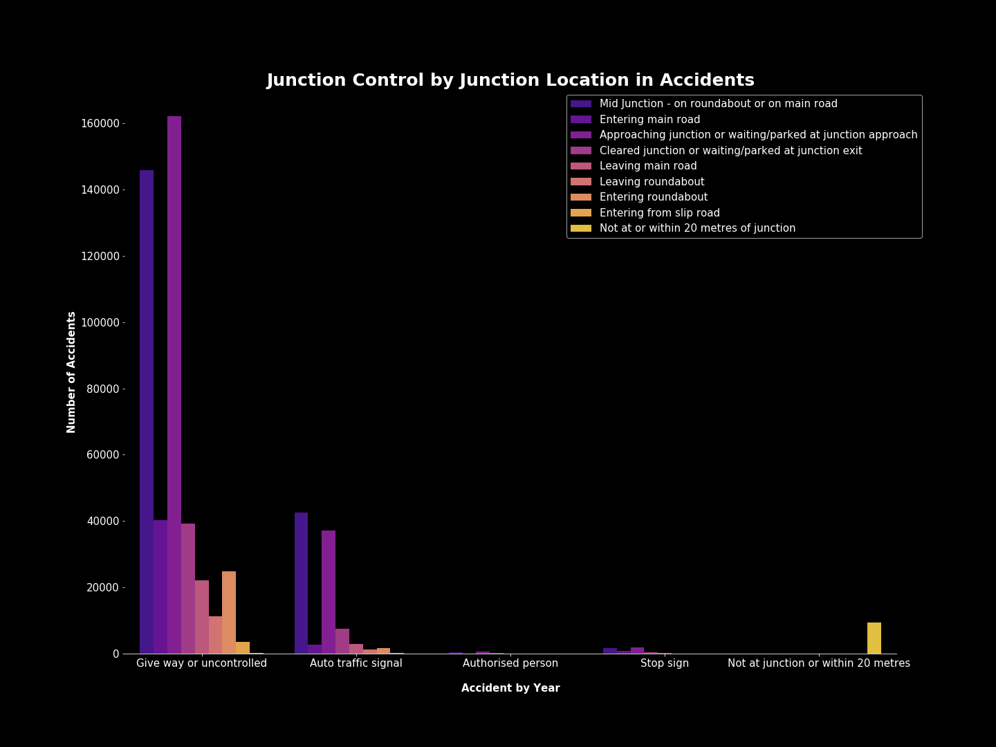

Slide 30
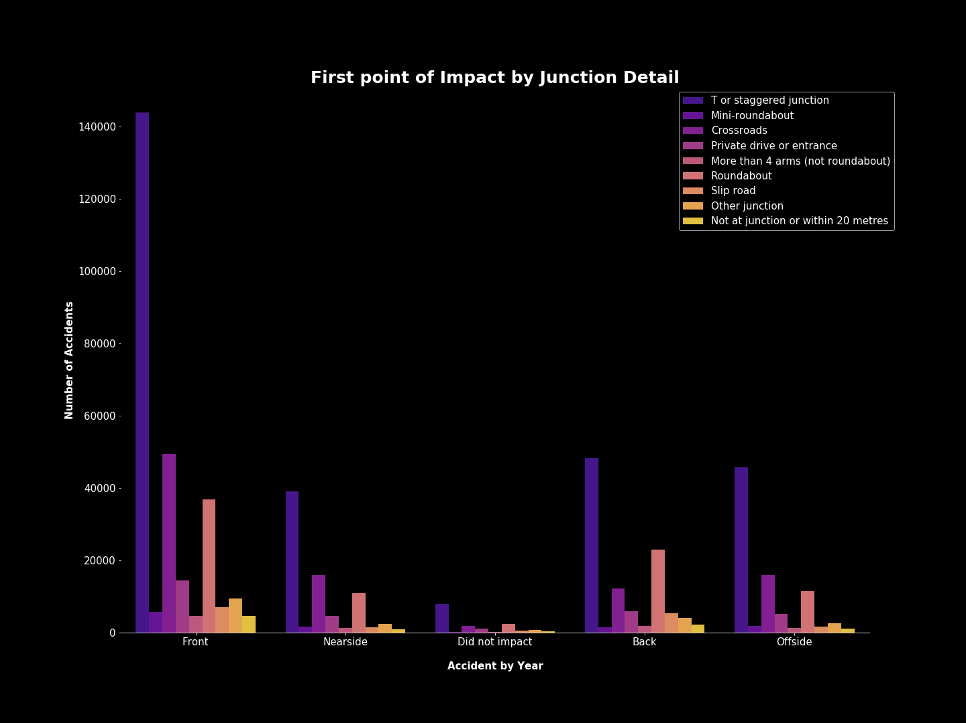

Slide 31
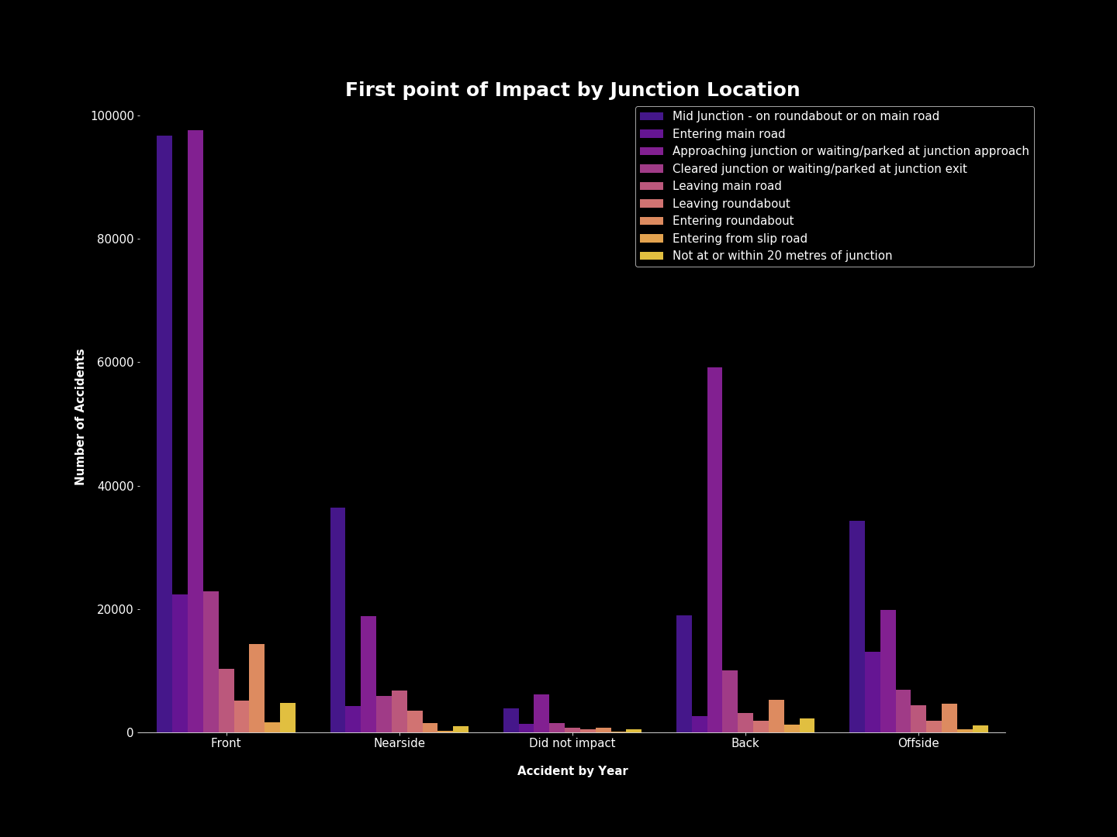

Slide 32
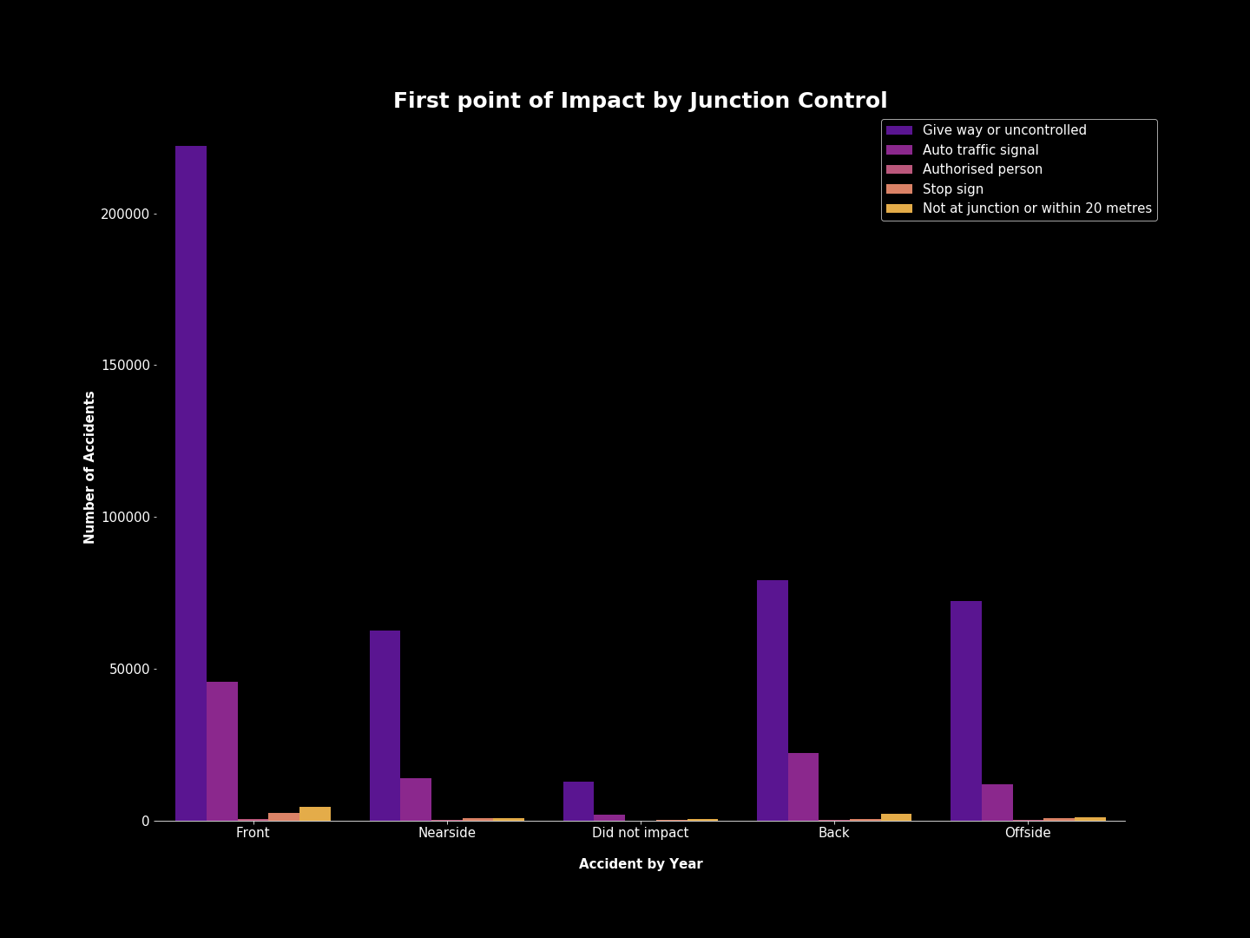

Slide 33
Other Visualizations Summary
No matter the situation above, the most accidents were involving areas that were uncontrolled. One of the main areas where this happened was in the Junction Detail T or staggered junction.
Other areas of concern include accident locations that included Mid Junctions on roundabouts or main roads.
No matter the location, detail, or location of impact the common denominator seems to be a lack of signage or control in junction areas.

Slide 34
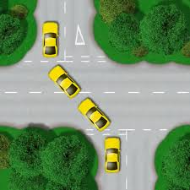
Possible Solution
From the data above more controlled areas would be beneficial. Maybe signs alerting drivers of the upcoming junctions, traffic lights, or stop signs would help in some of these areas where they are feasible.
For example, this is a staggered junction, the main junction detail in accidents. One can understand how a situation such as these can lead to numerous accidents especially if proper signage is not available. Perhaps traffic lights, stop signs, or warnings indicating that they are approaching certain junctions would help reduce accidents.

Slide 35
Can we create a machine learning algorithm that correctly predicts the severity of accidents?
For machine learning, decision tree and ensemble methods through sklearn, and other modules, will be used, and from them, the best performing method will be implemented.
The methods tested were:
Decision Tree
Extra Trees
Random Forest
Bagging
AdaBoost
Gradient Boost
XGBoost
Light GBM
The attributes to be considered in order to determine the best learning method include accuracy, F1, Precision, Recall, and Cross Validation Scores, Over/Underfitting, and training time.

Slide 36
LightGBM Classifier
After completing the chosen algorithms and tuning some of their parameters, the algorithm chose for this data was LightGBM Classifier.
When modeling the data I monitored the scores for all of them ranged around the same however, LightGBM performed the fastest for the amount of data being used.
The size of the data was medium to large and Light GBM’s algorithm is set up to handle such things.
***insert times and score for each*** in chart

Slide 37
Limitations
Not able to obtain accuracy over 70% without causing other issues such as overfitting
The data was extremely imbalanced. The majority of accidents were not serious and while this is not a real life problem, it was a problem for this model. Undersampling was done to improve overall scoring.
More factors surrounding accidents should be included in this data.
While there was information on the speed limit in certain areas, there was no information on whether the driver was speeding.
No information on cellphone usage of drivers
Rural areas had a higher rate of serious accidents which could be correlation to emergency vehicle arrival or distances from hospitals but this information was also not available

